Slide 2
What’s Coming to C#
William Fuqua

Slide 3
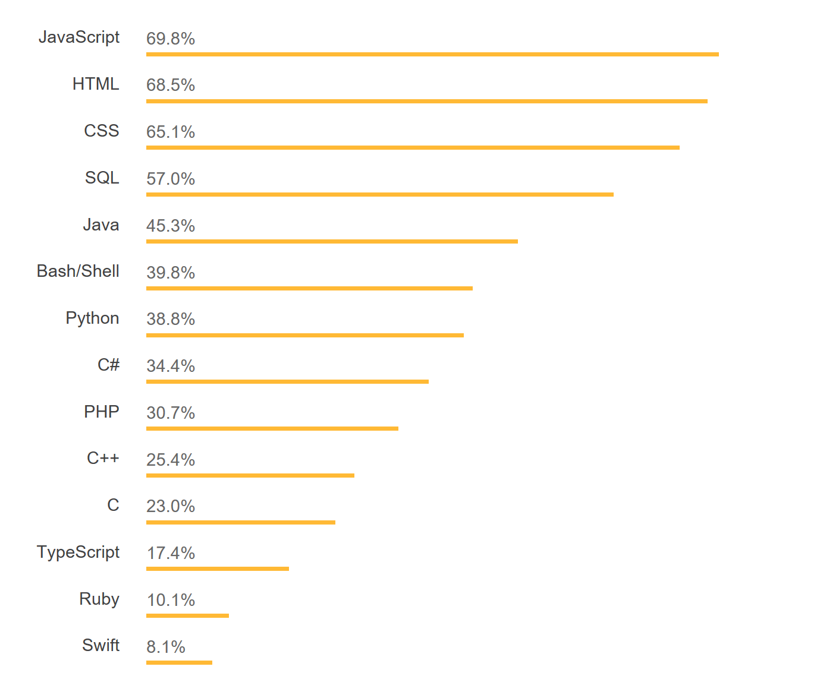
Most popular languages
https://insights.stackoverflow.com/survey/2018

Slide 4
Most popular (programming) languages
https://insights.stackoverflow.com/survey/2018

Slide 5
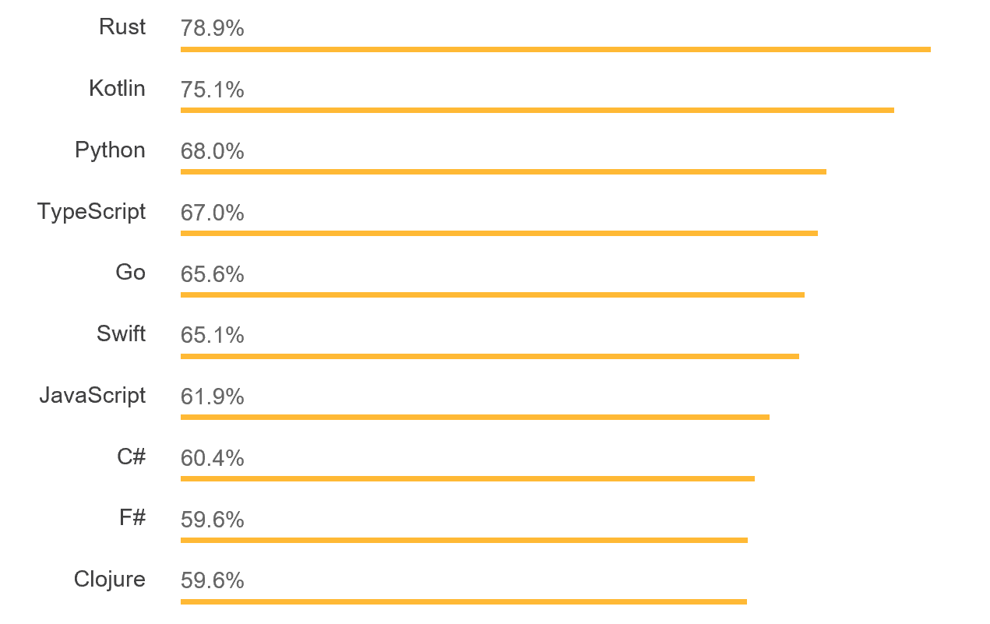
Most loved languages
https://insights.stackoverflow.com/survey/2018

Slide 6
Strategy
We will keep growing C# to meet the evolving needs of developers and remain a state of the art programming language.
We will innovate aggressively, while being very careful to stay within the spirit of the language.
Given the diversity of the developer base, we will prefer language and performance improvements that benefit all or most developers
We will continue to empower the broader ecosystem and grow its role in C#’s future, while maintaining strong stewardship of design decisions to ensure continued coherence.
https://blogs.msdn.microsoft.com/dotnet/2017/02/01/the-net-language-strategy

Slide 7
Strategy
We will keep growing C# to meet the evolving needs of developers and remain a state of the art programming language.
We will innovate aggressively , while being very careful to stay within the spirit of the language.
Given the diversity of the developer base, we will prefer language and performance improvements that benefit all or most developers
We will continue to empower the broader ecosystem and grow its role in C#’s future, while maintaining strong stewardship of design decisions to ensure continued coherence.
https://blogs.msdn.microsoft.com/dotnet/2017/02/01/the-net-language-strategy

Slide 8

C# 7.1, 7.2 and 7.3
C# 8.0
Safe, efficient code
Avoid garbage collection
Avoid copying
Stay safe
More freedom
Allow more things
Less code
Say it shorter

Slide 9
C# 7.1, 7.2 and 7.3

Slide 10
C# 8.0

Slide 11
Nullable and non-nullable reference types
string? n; // Nullable reference type
string s; // Non-nullable reference type
n = null; // Sure; it's nullable
s = null; // Warning! Shouldn’t be null!
s = n; // Warning! Really!
WriteLine(s.Length); // Sure; it’s not null
WriteLine(n.Length); // Warning! Could be null!
if (n != null) { WriteLine(n.Length); } // Sure; you checked
WriteLine(n!.Length); // Ok, if you insist!

Slide 12
Default Interface Members
interface ILogger
{
void Log(LogLevel level, string message);
}
class ConsoleLogger : ILogger
{
// send message
public void Log(LogLevel level, string message) { }
}

Slide 13
Default Interface Members
interface ILogger
{
void Log(LogLevel level, string message);
void Log(Exception ex) => Log(LogLevel.Error, ex.ToString());
}
class ConsoleLogger : ILogger
{
// send message
public void Log(LogLevel level, string message) { }
}

Slide 14
Default Interface Members
interface ILogger
{
void Log(LogLevel level, string message);
void Log(Exception ex) => Log(LogLevel.Error, ex.ToString());
}
class TelemetryLogger : ILogger
{
// send message
public void Log(LogLevel level, string message) { }
// capture crash dump and send message
public void Log(Exception ex) { }
}

Slide 15
Async streams and disposables
IAsyncEnumerable<Person> people = database.GetPeopleAsync();
foreach await (var p in people) { … }
using await (IAsyncDisposable resource = await store.GetRecordAsync(…)) { … }

Slide 16
More with Patterns
var s = o switch // match expressions {
int i => $"Number {i}",
Point(int x, int y) => $"({x},{y})", // recursive patterns
string s when s.Length > 0 => s,
null => "<null>",
_ => "<other>" };
state = match (state, request) // tuple patterns
{
(Closed, Open) => Opened,
(Closed, Lock) => Locked,
(Opened, Close) => Closed,
(Locked, Unlock) => Closed,
};

Slide 17
Places to go, things to do…
Get the previews, and send us feedback!
github.com/dotnet/csharplang/wiki
Check the docs:
docs.microsoft.com/en-us/dotnet/csharp/whats-new/

